Slide 1
Discrete Mathematics
Dr. Han Huang
South China University of Technology
1

Slide 2
Chapter 4. Graphs
Graph Coloring
Section 4.8
2

Slide 3
Contents
1
Introduction
2
Application
3

Slide 4
Introduction
4

Slide 5
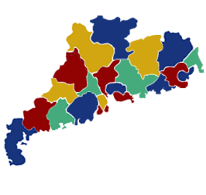
When a map is colored, two regions with a common border are customarily assigned different colors.
5

Slide 6
Introduction
One way to ensure that two adjacent regions never have the same color is to use a different color for each region.
However, it would be hard to distinguish similar colors.
A small number of colors should be used whenever possible.
The problem is to determine the least number of colors that can be used to color a map so that adjacent regions never have the same color.
6

Slide 7
B
B
A
G
C
D
F
C
A
E
E
D
Four colors suffice, but three colors are not enough.
7

Slide 8
Dual graph
Each map can be represented by a graph.
Each region is represented by a vertex.
Edges connect two vertices if the regions represented by these vertices have a common border.
Two regions that touch at only one point are not considered adjacent.
The resulting graph is called the dual graph of in the plane has planar dual graph.
8

Slide 9
B
G
C
D
F
A
E
B
C
D
G
A
F
E
9

Slide 10
B
A
C
E
D
B
E
A
C
D
10

Slide 11
Coloring
Definition 1 A coloring of a simple graph is the assignment of a color to each vertex of the graph so that no two adjacent vertices are assigned the same color.
A graph can be colored by assigning a different color to each to of its vertices.
However, for most graphs a coloring can be found that uses fewer colors than the number of vertices in the graph.
11

Slide 12
Chromatic Coloring
Definition 2 A chromatic number of a graph is the least number of colors needed for a coloring of this graph.
We are asking for the minimum number of colors required to color a planar map so that no two adjacent regions are assigned the same color.
This question has been studied for more than 100 years.
12

Slide 13
The Four Color Theorem
Theorem 1 The chromatic number of a planar graph is no greater than four.
The theorem was posed as a conjecture in the 1850s. It was finally proved by the American mathematics Kenneth Appel and Wolfgang Haken in 1976.
Prior to 1976, many incorrect proofs were published, often with hard-to-find errors.
13

Slide 14
The Four Color Theorem
The most fallacious proof in all of mathematics is the incorrect proof published by a London barrister and amateur mathematician, Alfred Kempe.
His proof is accepted as correct until 1890.
Percy Heawood found an error that made Kempe’s argument incomplete.
However, Kempe’s line of reasoning turned out to be the basis of the successful proof given by Apple and Haken.
14

Slide 15
The Four Color Theorem
They showed that if the Four Color Theorem were false, there would have to be a counterexample of one of approximately 2000 different types, and they then showed that none of these types exists.
They used over 1000 hours of computer time in their proof.
Their proof generated a large amount of controversy, since computers played such an important role in it.
15

Slide 16
The Four Color Theorem
Note that the Four Color Theorem applies only to planar graphs.
Nonplanar graphs can have arbitrarily large chromatic numbers, as will be shown in Example 2.
Two things are required to show that the chromatic number of a graph is k.
1. The graph can be colored with k colors.
2. The graph cannot be colored using fewer than k colors.
16

Slide 17
Example 1
What are the chromatic numbers of the graphs G and H as follows?
b
e
b
e
a
d
g
a
d
g
c
f
c
f
G
H
17

Slide 18
Example 1
Solution: The chromatic number of G is at least three, since a, b, and c must be assigned different colors.
To see if G can be colored with three colors, assign red to a, blue to b and green to c.
b
e
a
d
g
c
f
G
18

Slide 19
Example 1
The graph H is made up of G with {a, g}.
Hence, g is adjacent to vertices colored red, blue, and green, a fourth color, say brown, need to be used.
b
e
a
d
g
c
H
f
19

Slide 20
Example 2
No two vertices can be assigned the same color, since every two vertices of this graph are adjacent.
Hence, the chromatic number of K_{n} is n.
Four Color Theorem cannot hold for the nonplanar graph.
a
b
e
c
G
d
20

Slide 21
Example 3
The number of colors needed may seem to depend on m and n. Only 2 colors are needed.
Color the set of m vertices with one color and the set of n vertices with a second color.
a
b
c
d
e
f
g
G
21

Slide 22
Example 4
Two colors are needed to color Cn when n is even. The n-th vertex can be colored blue, since the two vertices adjacent to it, namely the (n-1)st and the first vertices, are both colored red.
a
b
f
c
e
d
C6
22

Slide 23
Example 4
When n is odd and n>1, the chromatic number of Cn is 3. To see this, pick an initial vertex. To use only two colors, it is necessary to alternate colors as the graph is traversed in a clockwise direction.
a
b
e
c
d
C5
23

Slide 24
Algorithm for coloring
The best algorithms known for finding the chromatic number of a graph have exponential worst-case time complexity.
Even the problem of finding an approximation to the chromatic number of a graph is difficult.
It has been shown that if there were an algorithm with polynomial worst-case time complexity that could approximate the chromatic number of a graph up to a factor 2.
24

Slide 25
Application
25
25

Slide 26
Example 5
Scheduling Final Exam: How can the final exams at a university be scheduled so that no student has two exams at the same time?
The scheduling problem can be solved using a graph model, with vertices representing courses and with an edge between two vertices if there is a common student in the courses they represent.
26

Slide 27
1
7
2
1
6
3
7
2
5
4
6
3
No student has two exams at the same time.
5
4
27

Slide 28
Example 6
Frequency Assignments: Television channels 2 through 13 are assigned to stations in North America so that no 2 stations within 150 miles can operate on the same channel.
Construct a graph by assigning a vertex to each station. Two vertices are connected by an edge if they are located within 150 miles of each other. Each color represents a different channel.
28

Slide 29
Example 7
Index Registers: In efficient compilers, the execution of loops is speeded up when frequently used variables are stored temporarily in index registers in the central processing unit.
Let each vertex of a graph represent a variable in the loop. There is an edge between two vertices if the variables they represent must be stored in index registers at the same time.
29

Slide 30
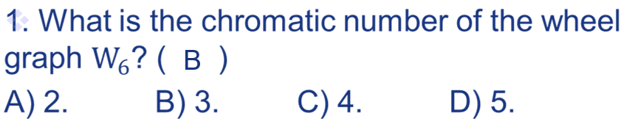
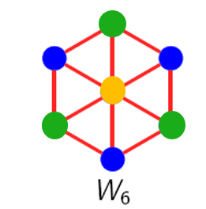
Exercises
Notes:
已修改

Slide 31
Exercises
2. The chromatic number of C_{n} (cycle graph) is ___
3 when n is odd and 2 when n is even (n>=2)
Notes:
已修改

Slide 32
Exercises
3. Which statement is wrong? ( )
A. Q_{n} (n-cubes graph) is always bipartite
B. C_{n}’s (cycle graph) chromatic number is 2 or 3
C. W_{n} (wheel graph) has n(n-1)/2 edges
D. There are n(n-2) 0s in the adjacency matrix for C_{n}
C
Notes:
已修改

Slide 33
Exercises
5. The chromatic number of K_{m,n} is ______
2
Notes:
已修改

Slide 34
Exercises
6. Let G be a planar graph with 10 connected components, 781 vertexes. Then, the chromatic number of G is at most ___
4
Notes:
已修改

Slide 35
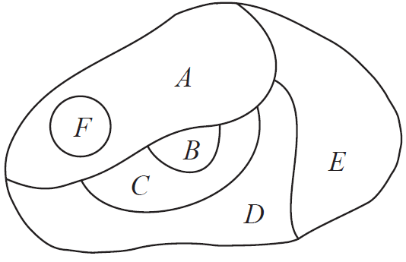
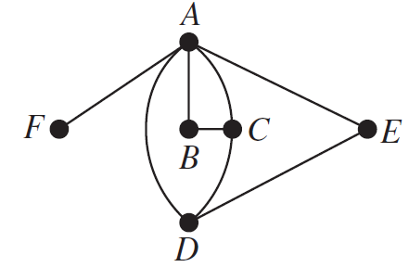
Exercises
8. Please construct the dual graph for the map shown. Then find the number of colors needed to color the map so that no two adjacent regions have the same color.
Three colors
Notes:
已修改

Slide 36
Exercises
9. Determine whether the given graph is planar or bipartite? (Y or N)
Whether the given graph has an Euler circuit or Hamilton circuit? (Y or N)
What is the chromatic number of each of the following graph?
A
B
C
planar or bipartite
A: NN
B: YY
C: YY
Euler or Hamilton
A: NY
B: NY
C: NN
chromatic number
A: 4
B: 2
C: 2
Notes:
已修改

Slide 37
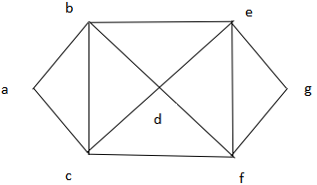
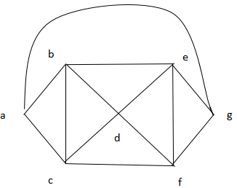
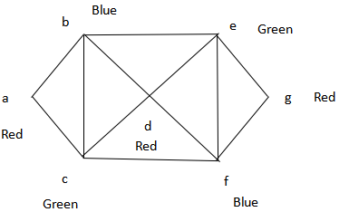
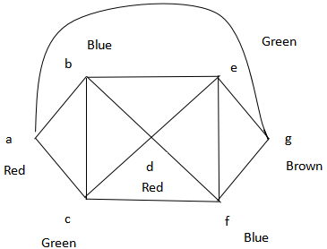
Exercises
10. What are the chromatic numbers of the graphs G and H shown in Figures?
Notes:
已修改

Slide 38
End of Section 4.8
Click to edit company slogan .
38

